Slide 1


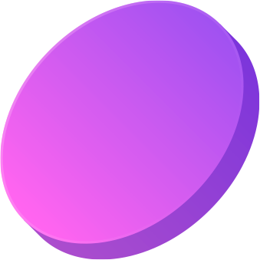


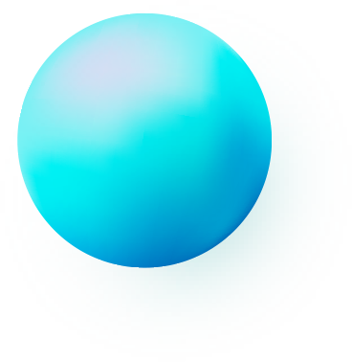
Blender 3D for design
Presentation by Denisov Roman

Slide 2
What is Blender
Blender 3D is a powerful and completely free open-source 3D graphics software. It can do literally everything from modeling complex characters and architecture to photorealistic rendering, animating feature films, and even editing videos.

Slide 3
What is Blender
It includes tools for sculpting, physics simulation, motion tracking, and compositing. Despite its professional capabilities, Blender has a friendly and active community that helps newcomers get started. With its versatility and zero cost, it has become the industry standard for independent artists and large studios worldwide, opening the door to 3D creativity for everyone.

Slide 4
Interesting facts
Blender
Blender was born out of a crisis. It was originally an in-house development at NeoGeo, but when the studio went bankrupt, founder Ton Rozendal refused to let the program disappear.
The Blender community is its main driving force. The program is developed not only by the foundation, but also by thousands of enthusiasts from all over the world.
Under the hood, Blender but also a powerful environment for developers. Its functionality is almost completely accessible through the Python API.
Earth is the third planet from the Sun and the only oIn 2022, Blender, became the only 3D package officially certified by the Academy of Motion Picture Arts and Sciences (the same organization that awards the Academy Awards).ne that harbors life

Slide 5

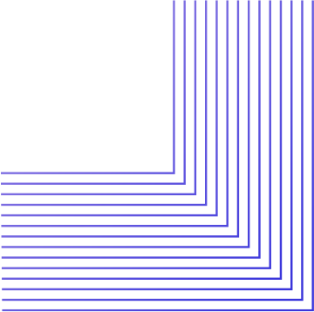
The slide title goes here!
Blender can be an incredibly useful tool for IT students, going far beyond just 3D modeling. It serves as a practical ground for applying knowledge from different fields. For example, for future game developers, it is indispensable for creating and exporting assets directly into engines like Unity or Unreal Engine.
Students studying computer vision and machine learning use Blender to generate synthetic datasets — the program allows you to automatically create thousands of photorealistic images of objects with labels for training neural networks.

Slide 6
Thank you for your attention!

